Slide 1
Introduction to Unix
Architecture and Basic Commands

Slide 2
Course Content
Introduction and Brief History of Unix
Unix System Architecture
Unix Session and Login Information
Unix Help
Unix File System
File Path’s
File Attributes
Links in Unix
File Ownership
File Permission
File Related Commands
Team TEX

Slide 3
What is Unix ?
Unix is an Operating system. Operating system is basically a suite of programs that make the computer work. The operating system is the master controller of the computer. It makes all the components of computer like disk drives , processor, keyboard work together. When we want a computer to perform certain job like starting a program, deleting a file, list the directory contents , all this is performed by Operating system.
Types of Unix : There are many different versions of unix available in the market. The most common are as below :
Ubuntu
Fedora
Sun Solaris
Mac OS

Slide 4
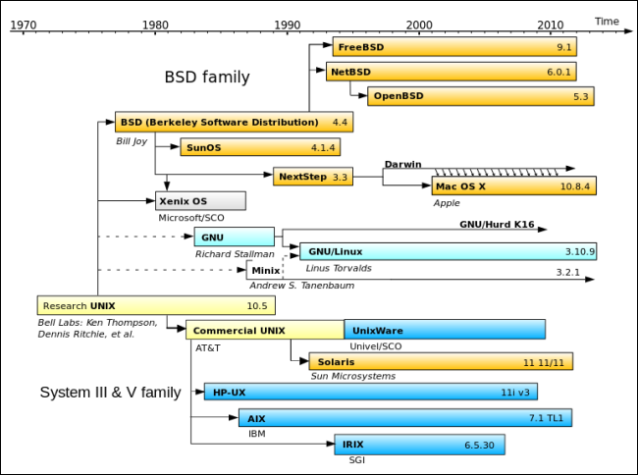

Brief History of Unix
Unix is an operating system like DOS and windows . It was originally developed by AT&T at bell labs.
Unix is basically designed to be multi-user, multi-processing, multi-tasking, portable.
We can interact with unix system through utility called shell.
Unix Operating system is generally characterized by hierarchical file system. A general thumb rule is that everything in unix is treated as file.
Unix os works on the philosophy of binding the programs together with the help of pipes and streams.
Unix Transition

Slide 5
Unix Architecture
The Unix OS mainly consists of following three parts :
Kernel : The Kernel is the core of Unix OS. It’s task is to allocate time and memory to the programs (through various scheduling algorithms) and perform various system calls. Apart from this, kernel provides various other services which include interrupt and trap handling, separation between user and system space, scheduling etc.
Shell : The shell acts as a interface between user and the kernel. When a user logs on to the Unix OS, the login program checks for the username and password, and then starts another program called the Shell. The Shell is a command line interpreter (CLI). It interprets the commands the user types in and arranges for them to be carried out.
Utility Programs: This consist of simple utility programs like cp which is used to perform copy operation, cd used to change directory etc. and also the complex utilities like shell which allow user to issue command.

Slide 6
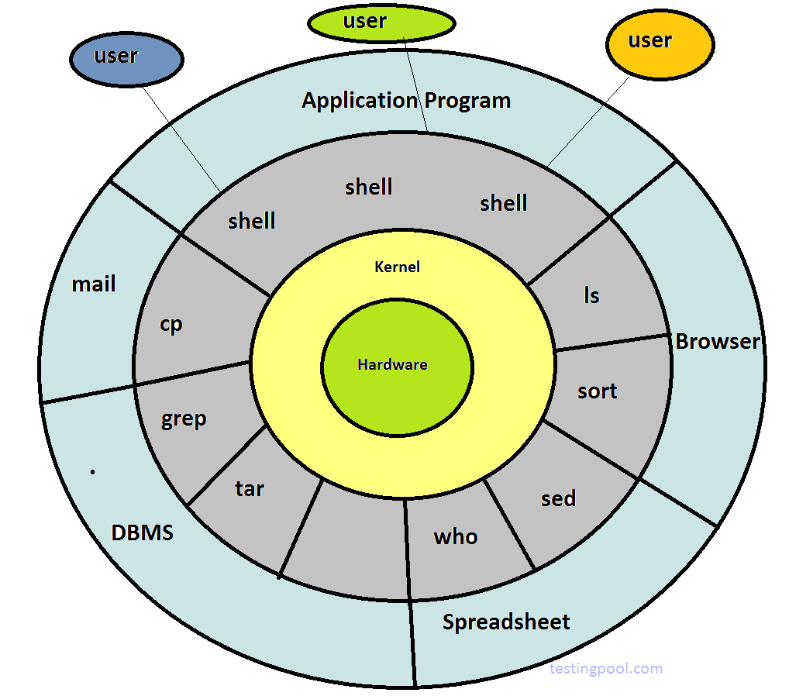
Unix Architecture
Below Diagram highlights Unix Architecture :

Slide 7
Unix Session and Login Information
A session on unix system starts immediately after you login and finishes after you logout.
To successfully login into unix os, a user must have username and password. A user can login into the unix os using :
A Console window or
Client server protocol like telnet/ssh
As soon as the user is logged in, he is immediately placed in his home directory. Each user has 2 numeric id's associated with him. ’id’ command is used to check the user and group id.
uid - unique to the user
gid - id which specifies the group to which user belongs.
The root is a special unix user which carries super privileges.

Slide 8
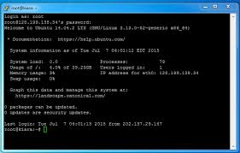
Unix Session and Login Information
The major file(s) used in unix that store login information are:
/etc/passwd --details like username, password(encrypted), user id, group id, username are mentioned in this file.
/etc/shadow - encrypted password are stored in this file.
Some of the Common Unix login commands are as below :
who - which users have logged in
su - basically used for super user login
logname - print user login name
uname - print system information
passwd - to change user password.
Logged in Successfully

Slide 9
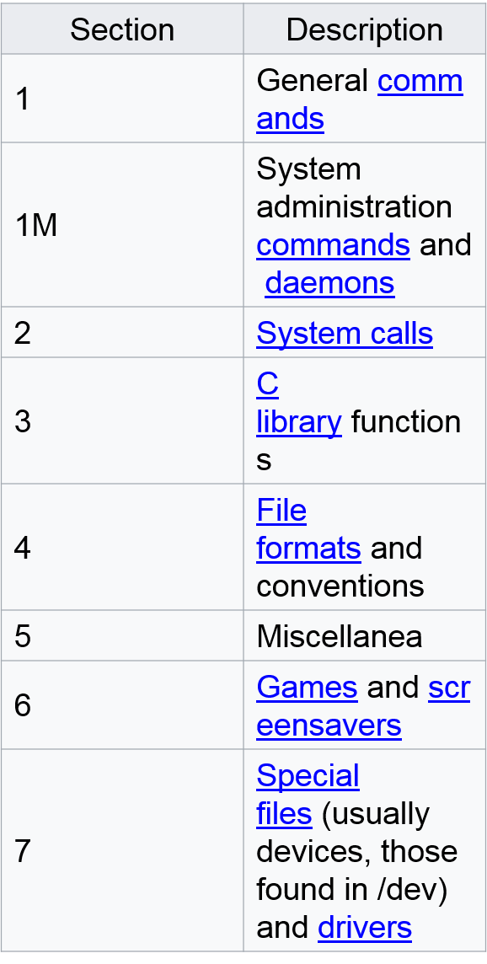
Unix Help
If you get stuck while operating the Unix OS, there is a list Unix commands which might help you out :
apropos - search the manual pages using keywords.
whatis - returns a short description of system commands.
info- read the documents in info format.
man -is the most widely used helpful command in unix. Documentation is usually available in the form of manual pages. man command is divided into different section as detailed below.
usage : man <section number> <topic name>
Man Command Sections

Slide 10
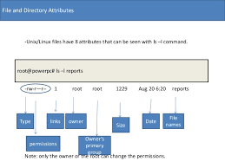
Unix File System
A file system is basically a way to store and organize the files. It makes it easy for the user to access information through files. It is a hierarchical arrangement of files and directories. Root is the base directory from where the path starts. The directory contains information about the various attributes of file :
Type of file.
Size of file.
Owner of file.
Permission of file.
Timestamp of file.

Slide 11
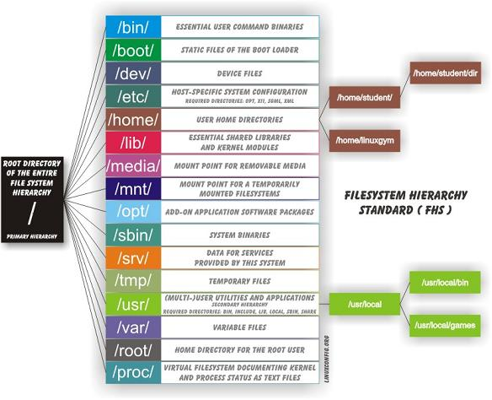
Unix File System
A typical unix file system is described as below :

Slide 12
Unix File System
/bin and /usr/bin - The directories where commonly used unix commands are stored.
/sbin and /usr/sbin - These directories contains command which can only be executed by system administrator.
/etc - This directory contains various configuration files, including password and shadow file(s).
/lib and /usr/lib - contains libraray files in binary format.
/usr/include - contains standard header files used by c programs.
/usr/share/man - manual pages are stored here.
/tmp - In this directory users are allowed to create temporary files.
/var - this contains all print jobs and outgoing and incoming mail.
/home - users home directory are stored here.

Slide 13
The UNIX File System
A file system is a logical method for organizing and storing large amounts of information in a way which makes it easy to manage.
There can be more than one file systems on any UNIX operating systems
There can be more than one type of file systems
Each disk file system on the UNIX operating system will have the following structure

Slide 14
The UNIX File System

Slide 15
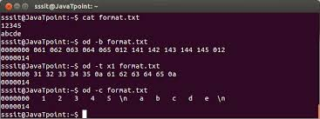
Unix File System
Unix looks at everything as a file. The file is a container for storing information. A file is basically a sequence of characters as shown by output of od command.
Directories and devices are also treated as files in unix. All physical devices including memory ,CD-ROM printer are treated as files. The shell is also a file.
The files are divided into following 3 categories :
Ordinary Files
Directory Files
Device Files

Slide 16
Unix File System
Ordinary Files - It contains data as stream of characters . An ordinary file is further divided into :
Text Files : contains printable characters and user can view them.
Binary Files : contains both printable and non printable characters.
Directory Files - which contain files and other directories inside it. A directory file contains entry for every file and sub-directory it contains. Each entry basically uses below two features(discussed in later slides) :
Name of the file.
Inode number of file or directory.(discussed in later slides).
Device Files : All devices and peripherals are represented by files. They are generally stored in /dev directory.

Slide 17
Unix File System
In India there is a concept of Aadhar card, which provides a unique identification to every individual. Similar to this Aadhar number there is Inode number which uniquely indentify each file in unix systems.
An Inode number points to an Inode.Internal representation of a file is given by an inode. An Inode stores the following information about a file :
Size of file
Device ID
User ID of the file
Group ID of the file
The file mode information and access privileges for owner, group and others
File protection flags
The timestamps for file creation, modification etc
Link counter to determine the number of hard links
Pointers to the blocks storing file’s contents

Slide 18
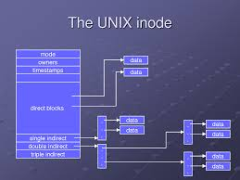
Unix File System
When a process refers to a file by it's name it is eventually referring to its inode.There is a Inode table which stores the mapping of Inode numbers with the respective Inodes. Space for Inodes is allocated when the operating system or a new file system is installed and when it does its initial structuring.
Inode Related commands
ls -i # i flag is used to print the Inode number for each file.
df -i # displays the inode information of the file system.
stat # display file statistics that also displays inode number of a file.
find . -inum 2921832 -exec rm -i {} \; # To remove file with inode number.

Slide 19
File Path
Files in a file system can be accesses using there path names. There are basically two types of pathnames:
Absolute Path name : In this method full path of filename is used to access the file starting from root. ex: /bin/date .
Relative path names: when we access the second directory wrt. to other directory. ex cd abc/current directory.
Two filenames are automatically created when user creates a new filename :
. - refers to the current directory.
.. - refers to the previous directory.
It is to be noted that we cannot use some special characters (like /) in the name of file.

Slide 20
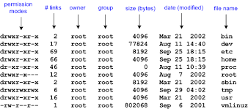
File Attributes
We can see the various files attributes with help of ls command when used with -l option.(similar to directory attributes)
Type- regular file(-)/ directory(d)/ symbolic link (l)/ character device(c)/ block device/(b)/named pipe(p)/ socket(s).
No of link's to file - including hard link and soft links.
owner and group owner of file.
size of file.
last access/modification time of file.
Name of file.
File Attributes

Slide 21
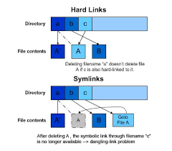
Links in Unix
A link is a mechanism in a way a user can refer to the contents of a file. These are generally of two types:
Hard link: These allow to have multiple names of a file. created by ln . Even if you remove the original file the hard link exist.
Syntax : ln <target> <link name> [target should already exist]
Limitations:
You cannot create 2 linked filenames in two different file system.
You cannot link a directory with hard link.
Soft Link : If you remove the original file, then link becomes the dangling pointer.This is a special file whose content basically contains pathname to other file, to which the link refers to.
Syntax : ln -s <target> <linkname> [ no limitatation that target should exist.]

Slide 22
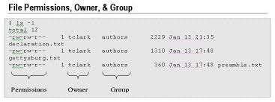
File Ownership
A user can check the owner and group associated with the file by ls -l command.(in third and fourth column).Several users belong to a single group.A single user can belong to mutiple groups.
user id(UID) - its name and numeric representation.
group id(GID) - its name and numeric representation.
Owner and group can be changed with the following commands :
chown <owner> file
chgrp <owner> file
File Ownership

Slide 23
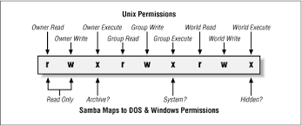
File Permission
Unix has a simple mechanism for assigning permissions to the file. We can view the current permission of file(s), by using ls -l commands.
Take a look at the first column of o/p. The first character (-), indicates that it is a an ordinary file.Divide the next 9 characters into three groups each. The first three characters signify permission of user, next 3 of the group and next 3 characters of other( anyone other from user and group.)
r--r----x - signifies user and group have read permission and others have execute permission only.
The default permissions of a file are calculated by umask value. Bu default, when a new file is created it has permission 777, and for directory it is 666. But when we use the ls -l command to view the results, we will find that the result is different(because of umask).
File Permission

Slide 24
File Permission
chmod - This command is used to change the file permissions.
Syntax: chmod <category> <operation> <permission> <pathname>
category - user group, others
operation - assign or remove a permission
permission - type of permission- read, write, execute
Example : chmod ugo+x abc.txt
It can either be set in octal mode as below :
r-4,w-2,x-1
chmod only changes the permission mentioned in command line and leaves the other permission unchanged.

Slide 25
File Related Commands
pwd – Tells your current directory , starting from root.
$pwd
cd – To change the directory mentioned as argument.
cd /home/hcl/TrainingData
mkdir – To create new directory.
mkdir –p /home/hcl/New1/New2/New3
rmdir – To remove empty directory.
rmdir New3
ls – To list the directory contents.
ls –lrt

Slide 26
File Related Commands
cat – To create a new file. Also used to open and append a file.
cat filename1 or cat > filename2 (to exit ctrl +d)
cp – To copy file directory from one location to another.
cp source_file new_file
mv – To move/cut file from one location to another.Also used to rename
mv source_file new_file
rm –To remove a file.
rm –f *.cpp
more - more is a command to see the contents of a text file one screen at a time
ls | more

Slide 27
File Related Commands
file – Determine the file type.
file abc.txt
wc - print newline, word, and byte counts for each file.
wc beta.txt
diff – compares file line by line.
diff abc1.txt abc2.txt
dos2unix/unix2dos - DOS/Mac to Unix and vice versa text file format converter.
dos2unix abc.cpp
gzip - reduces the size of the named files using Lempel-Ziv coding (LZ77). Whenever possible, each file is replaced by one with the extension .gz, while keeping the same ownership modes, access and modification times.
gzip sourcefile.txt

Slide 28
File Related Commands
gunzip - uncompresses a file that was compressed with "gzip“
cat dump.doc file1 test.sh | gzip > all.gz
gzip -l all.gz
umask - set file mode creation mask
umask 0002
umask=0002
find - search for files in a directory hierarchy
find / -type f -perm 0777 -print -exec chmod 644 {} \;
find . -type f -name "tecmint.txt" -exec rm -f {} \;
find / -mtime +50 –mtime -100

